Slide 1
Journey Map
Mohammad Aadil Sehrawat (INMSZ8)
Associate Data Engineer

Slide 2


Journey Map
Soft Skills
Mohammad Aadil Sehrawat (INMSZ8)
Associate Data Engineer

Slide 3
Key Learnings (14/08/23)
Professionalism and Etiquette
Adhering to the dress code
Difference between a college setting and a corporate setting
Behaviour in the office
Time Management
How to organize and manage time effectively
Reach out when need be. Be aware of capabilities and limitations

Slide 4
Key Learnings (16/08/23)
Video, Audio, Chat based Communication
The approach to a meeting and one's mannerisms can vary depending on the communication medium used.
Be concise
Listening vs Hearing
Understood the value of teamwork and how to be a team-player

Slide 5
Key Learnings (17/08/23)
Email Etiquette
Communication Skills
Body Language
Listen, Understand and Empathise
Presentation Skills
Fluency
Addressing the audience
Mannerisms
Avoiding fillers

Slide 6

Journey Map
Foundational Skills
Mohammad Aadil Sehrawat (INMSZ8)
Associate Data Engineer

Slide 7
Business Analysis & Agile (18/08/23)
Professionalism and Etiquette
Adhering to the dress code
Behaviour in the office
Difference between a college setting and a corporate setting
Time Management
How to organize and manage time effectively
Reach out when need be. Be aware of capabilities and limitations

Slide 8
Scrum Call (21/08/23)
Understanding Agile DevOps on Azure in depth
Backlogs, Boards
Test plan, User stories, Epics, Issues etc.
Sprint (+ Iteration) creation
Mock daily stand-up meeting
Conducted a team exercise by hosting a simulated Scrum call for a fictitious application.
Played the role of a Product Owner during the stand-up meeting
Visualize on Kanban Board

Slide 9
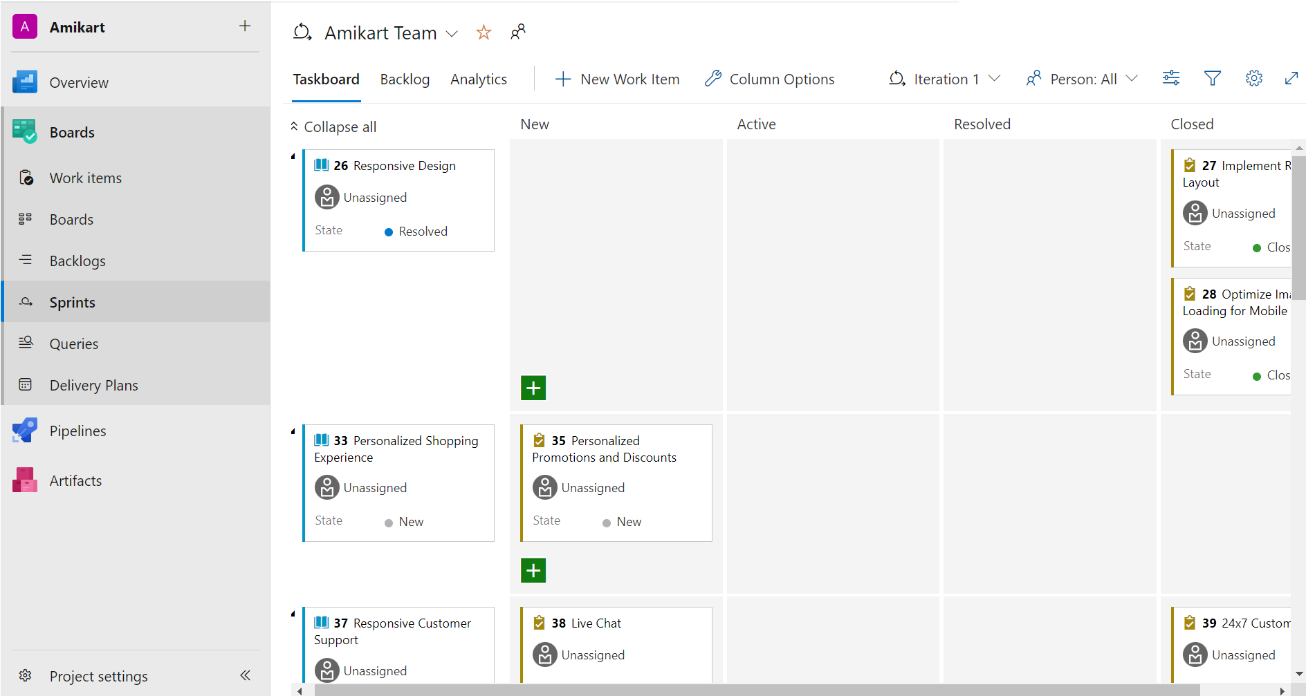
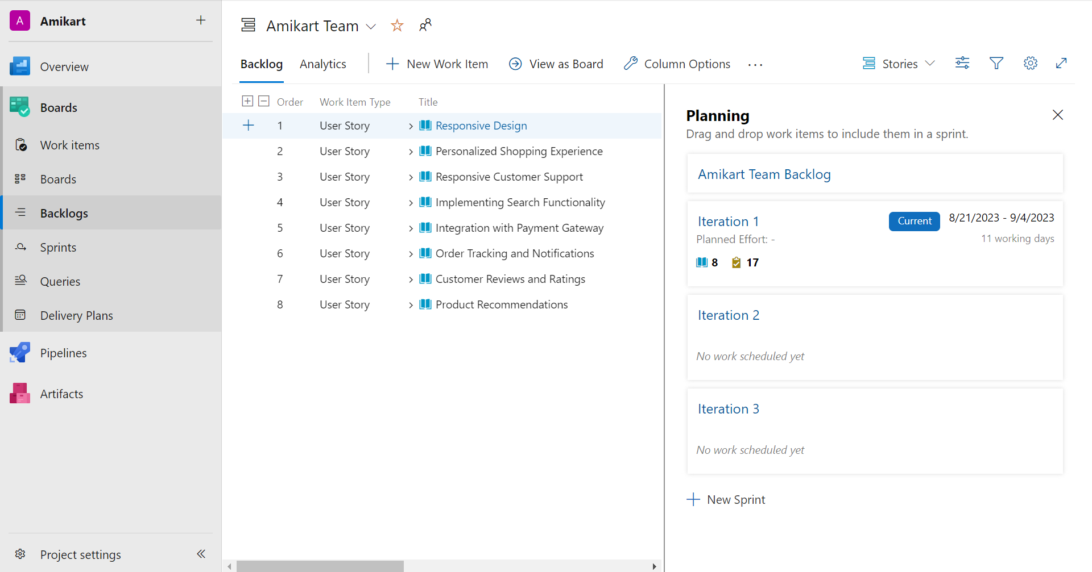
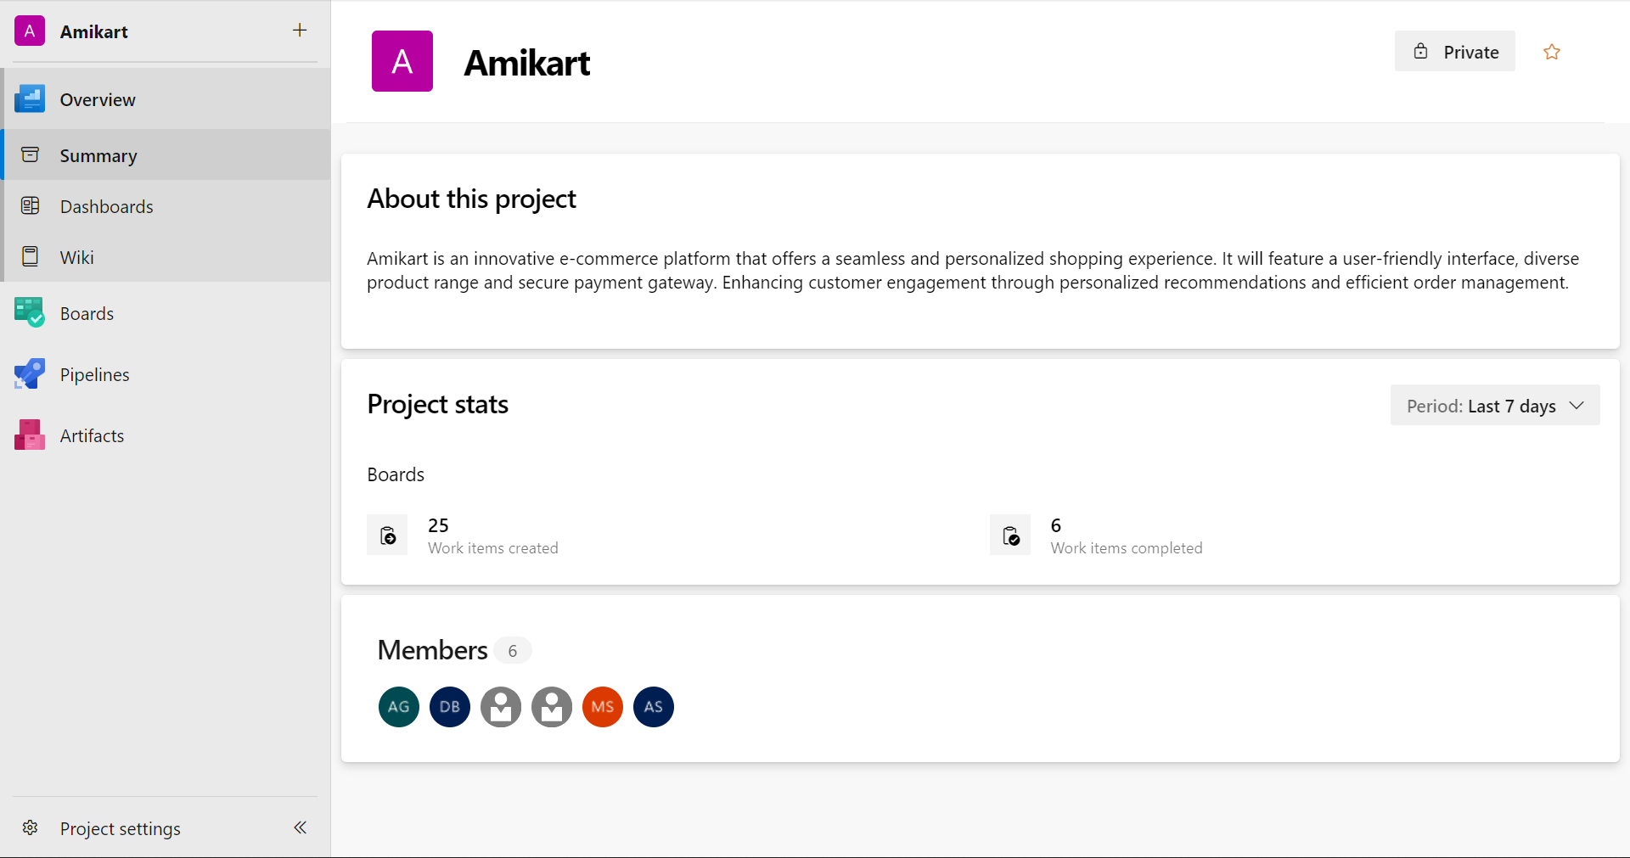
Sprints
Backlogs
Organization Structure

Slide 10
DBMS (22/08/23)
SQL
DML, DDL, DQL, DCL, TCL
SELECT, WHERE, ORDER BY, GROUP BY, HAVING
Hands-on session of different SQL Queries
Sub-Queried
Understood Single-Row, Multiple-Row, Multiple-Column, Correlated, Nested, etc. sub-queries
Joins – Inner (Natural), Outer, Left join

Slide 11
Testing (23/08/23)
Software Development Life Cycle (SDLC)
Types of SDLC – Waterfall model, Agile model
Software failure and scope to trackback with respect to different development models
Software Testing Life Cycle (STLC)
Phases of STLC – Test Strategy, Plan, Design, Environment, Execution, Reporting, Closure
SDLC vs STLC

Slide 12
DevOps (24/08/23)
Continuous Integration and Continuous Deployment
Repository based DevOps process to make continuous changes for automation and testing
Discussed CI vs CD
GitHub Actions
Components of GitHub Actions – Workflows, Events, Jobs, Actions, Runners
Sample Action file in YAML file format

Slide 13
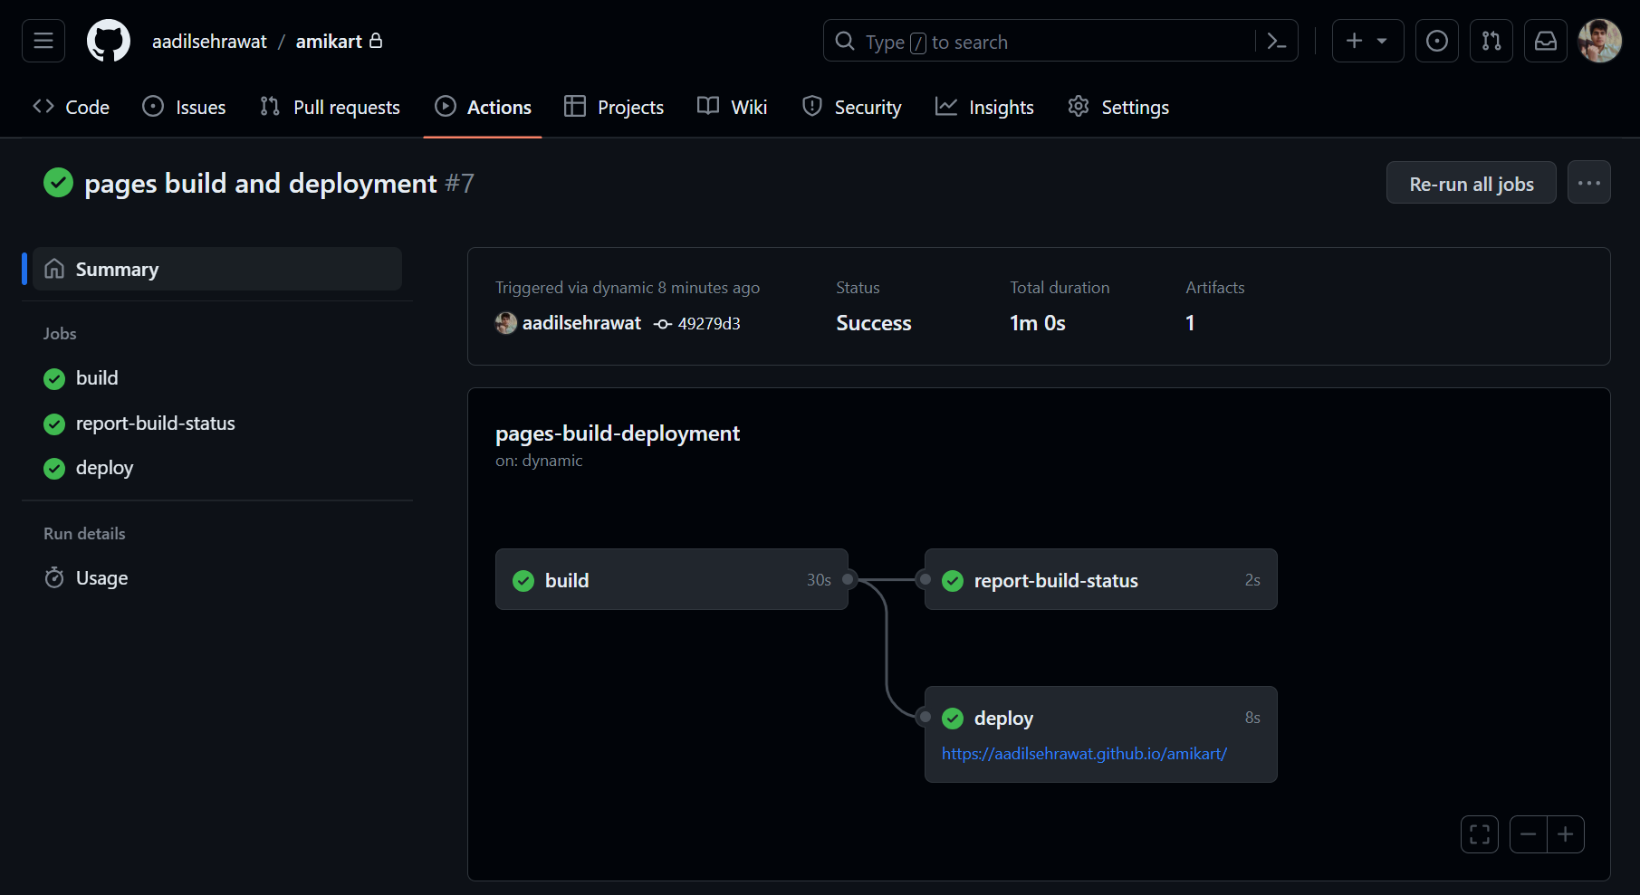
Successful Github Action for Github-Pages build and deployment

Slide 14
Cloud Computing (25/08/23)
Cloud Computing
What is cloud computing, it’s advantages and limitations
Concepts such as SAAS, PAAS, IAAS with examples
Using Azure’s suite of Cloud Computing tools
Virtual Machines
Creating VMs on Azure and accessing them remotely
Behaviour in the office
Reach out when need be. Be aware of capabilities and limitations

